Slide 1
Knowledge Representation Schemes
(KRS)

Slide 2
What you have already learnt?
Knowledge representation
  Declarative
    Logic representation
      Deductive
      Inductive
      computational logic
        Propositional logic
        Predicate logic
        Quantifiers
  Procedural

Slide 3
What are you going to learn today!!
Knowledge representation schemes
  Declarative
    Logic based systems
      Deductive reasoning
      Inductive reasoning
      Types of computational logic
        Propositional logic
        Predicate logic
    Semantic networks
    Frame-based systems
    Scripts
    Production rules
Already done

Slide 4
Semantic network
It is one of the oldest and easiest way to represent knowledge in a graphical way
It represents the knowledge having hierarchical relationship b/w them
This representation is in graphical form consisting of:
  Nodes:
    That represent objects or concepts
  Links:
    representing relations between the nodes. The links are directed and labeled.

Slide 5
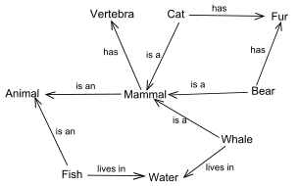
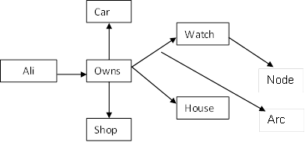
Figure 1: Semantic network…

Slide 6
Figure 2: Nodes and Arcs
Arcs define binary relationships that hold between objects denoted by the nodes
mother
age
Sue
john
5
age
wife
father
husband
mother(john,sue)
age(john,5)
wife(sue,max)
age(max,34)
...
34
Max
age

Slide 7
Semantic network …
Advantages
  It is a very flexible method of knowledge representation
  There are no hard rules about putting the knowledge in this form
  It is more useful in the sense that it shows inheritance and is therefore hierarchial in nature

Slide 8
Semantic network …
Implementation in computer
  Although semantic network is graphical in nature but it does not appear this way in computer.
  Here, the objects and their relationship is stated in verbal form and then implemented using any programing language.

Slide 9
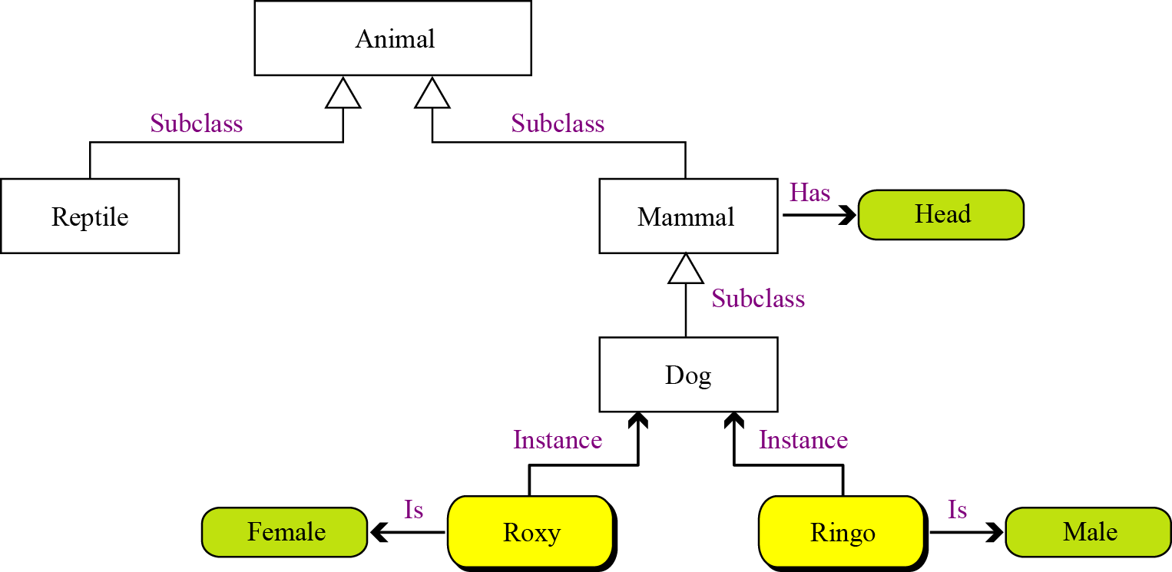
Figure 3: Example of Semantic network

Slide 10
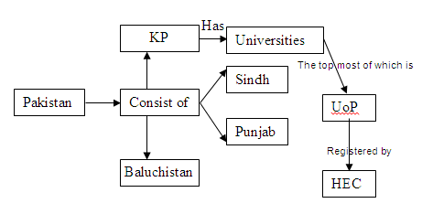
Figure 4: Semantic network …

Slide 11
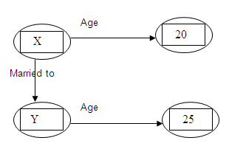
Figure 5: Semantic network …

Slide 12
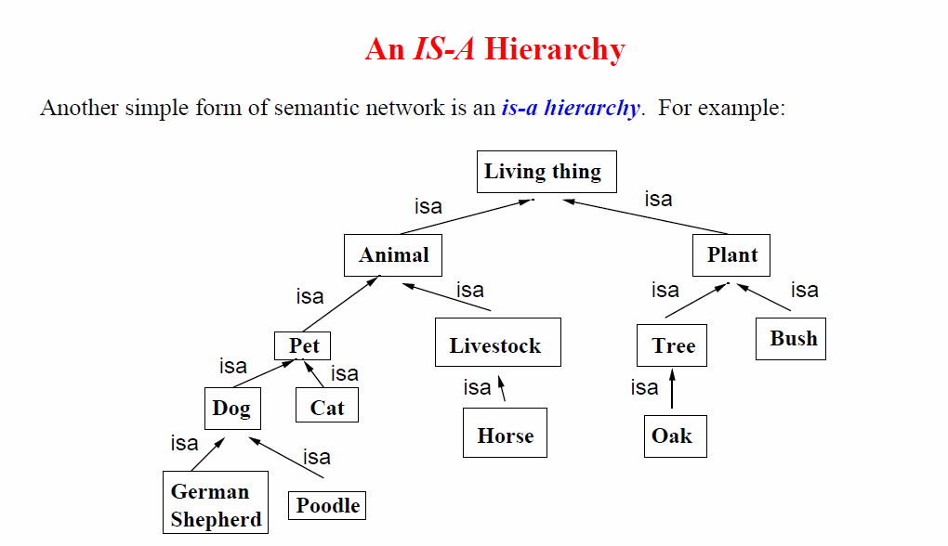


Slide 13
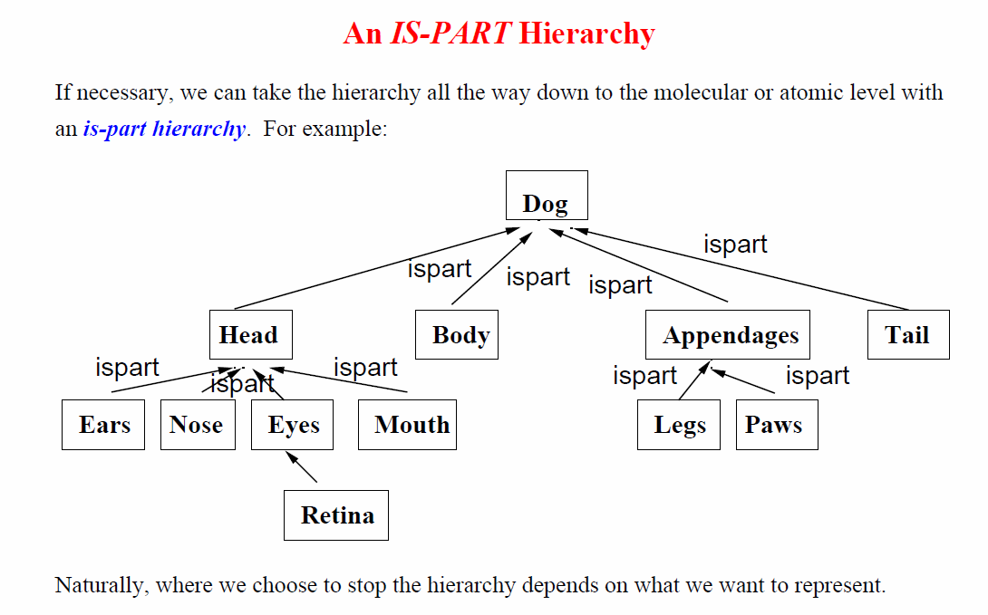

Slide 14
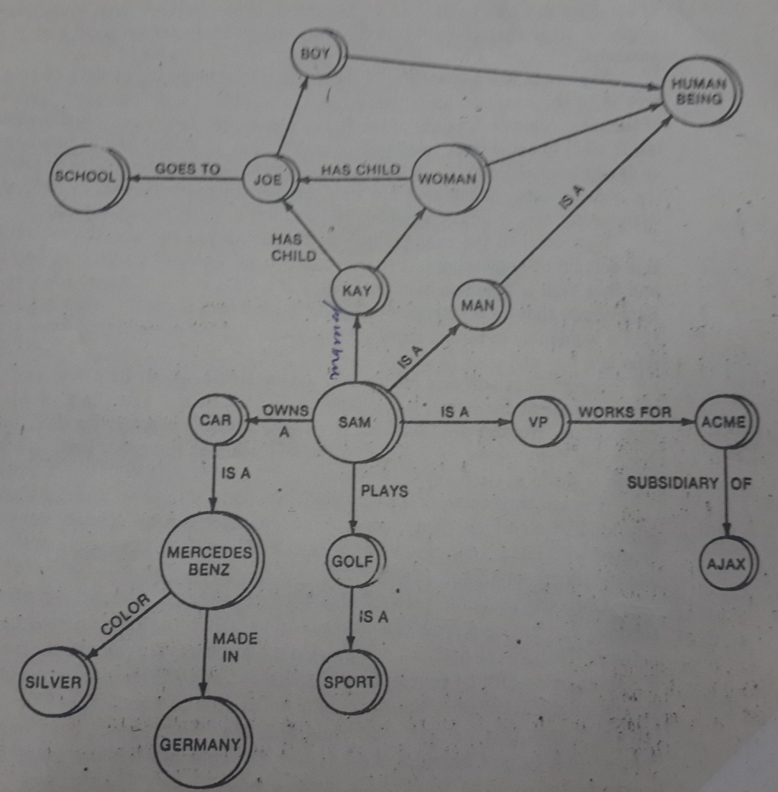
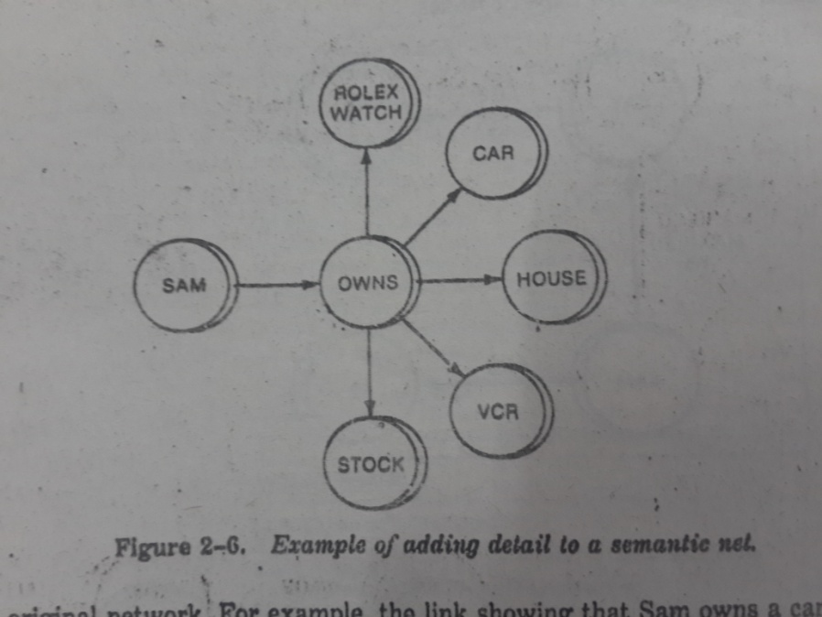
Book Examples

Slide 15
Schema
A method of organizing, presenting and using stereotyped knowledge for computer reasoning.
Stereotype : a fixed, well known knowledge, knowledge acquired on the basis of previous exposure to typical objects and situations.
There are two types of schemas
  Frames
  Scripts

Slide 16
Frame-based system
Used for the representation of stereotypical situations and knowledge
A frame provides a way for representing knowledge in slots that contains characteristics and attributes
In physical form of a frame is an outline with categories and sub-categories.

Slide 17
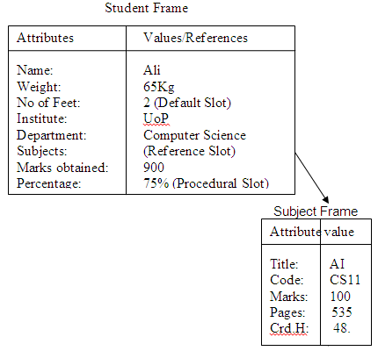
Figure 6: Frame-based system

Slide 18
Frame-based system
Types of slots
  Default Slot
    Which contains the default values i.e. number of wheels, number of doors of a sedan car
  Procedural Slot
    Which requires certain formula/procedure on the if-need basis, e.g Percentage
  Referential Slot
    Which references to another frame for further detail of the slots. These frames are connected through pointers i.e Subjects attribute in the student frame that refers to the Student frame
  Blank slots
    left blank unless required for a task

Slide 19
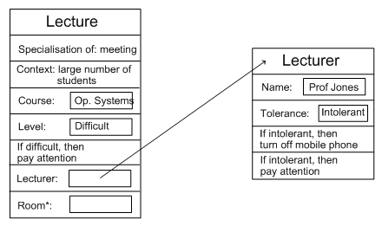
Figure 8: Frame-based system

Slide 20
Frame-based system
Programming frames
  The frame itself are programed using A.I programing languages
  Special frame based s/w development tools are available which don’t require any programing skill but only have to put the values and attributes in the frames

Slide 21
Frame-based system
Advantage
  Expressivity, flexibility, and ease of use
Disadvantages
  The lack of precision, and lack of a well defined model of inference
  Can not be used in a complex situation

Slide 22
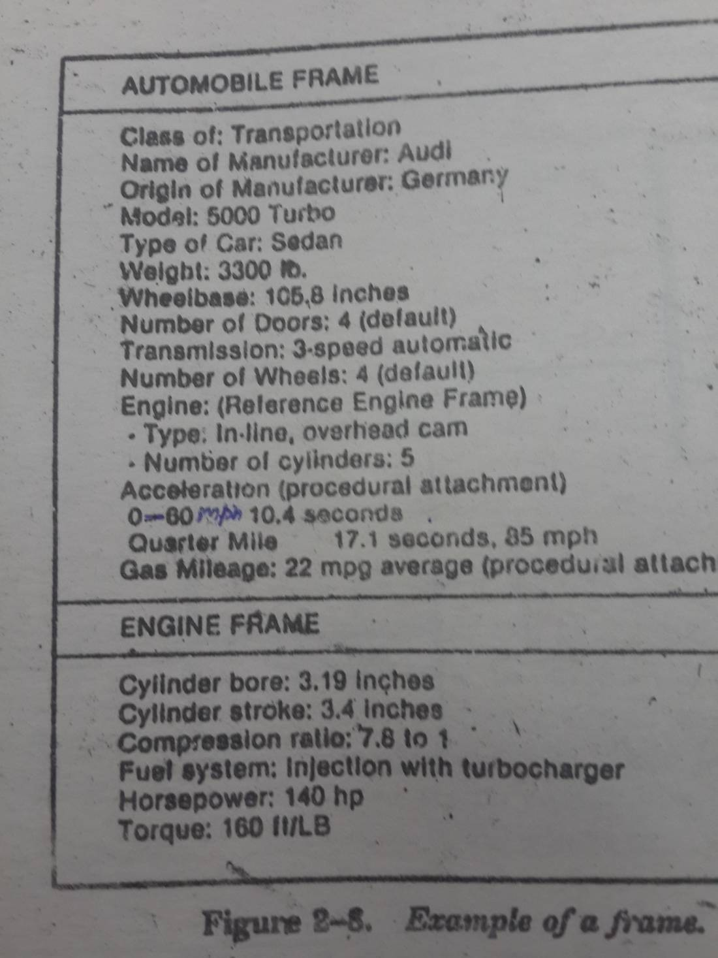
Book Example

Slide 23
Scripts
Used to represent stereotyped knowledge
It is similar to frames in the sense that it also consists of slots but differs in the sense that it explains event not objects (like frame)
Here, the slots consist of objects, people, and actions that are involved in events

Slide 24
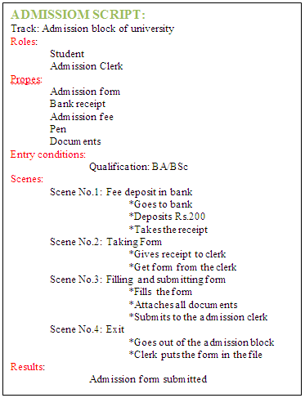
Figure 9:Scripts

Slide 25
Scripts
Elements of a script
  Tracks
    It refers to variation that might take place in a script. Actually it describes the name of the events
  Entry condition
    It describes situation that must be satisfied before the start of event
  Props
    It refers to the objects involved in the events
  Roles
    It refers to the people involved in the script
  Scenes
    Describes the actual sequence of events that occur
  Results
    Describes the conclusion that is drawn from the scripts.

Slide 26
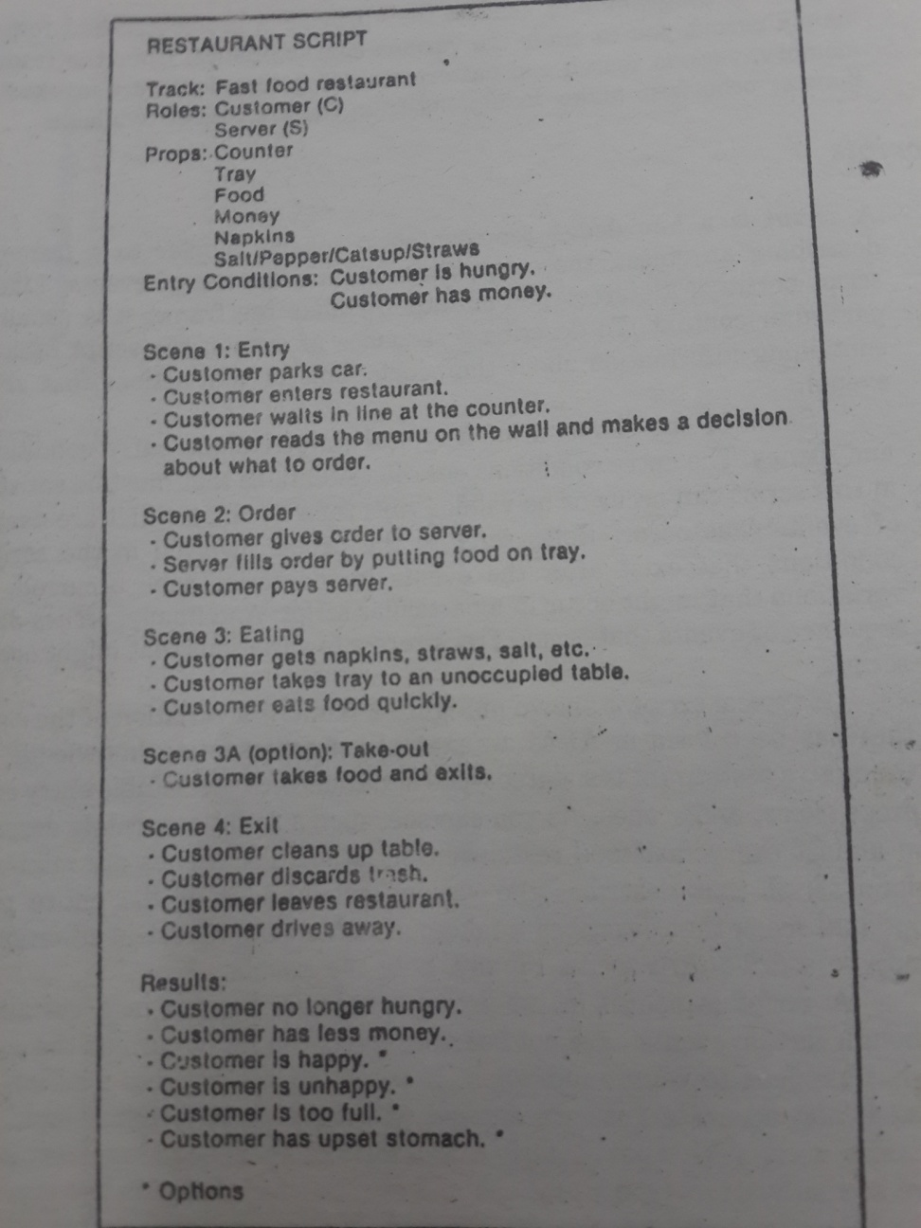
Book Example

Slide 27
Production Rules
Is a popular method of knowledge representation
A Production or rule is a two–part statement containing small piece of knowledge i.e.
  If the price of book is less than Rs.100 then purchase it
Each rule consist of two parts:
  Antecedent/ situation/premises
  Consequent/Action/Conclusions.

Slide 28
Production rules …
In a production or Rule the first part is preceded by the keyword IF and the second by the keyword THEN
In the above example
  ANTICEDENT
    if the price is less than Rs.100
  CONSEQUENT
    purchase the book
In rules, if the first part of the rule is correct/true then the second will be true otherwise false

Slide 29
Production rules …
Logical operators in production
  In rules we can also use the logical AND and logical OR operators to make the rules more affective and meaningful i.e.
  IF you need to pass
  OR you need to get good marks
  THEN you have to work hard

Slide 30
Production rules …
Advantages
  It is one of the most feasible forms of knowledge representation.
  They are easy to create and understand
  The format of rules is compatible to the format of our mind to store and apply knowledge

Slide 31
Production rules …
Production system or rule-based system
  A system that represents it knowledge in its knowledge base by rules is called The production system
  Example
    Expert System

Slide 32
Production rules …
Examples
IF the price of the stock drops below $250
THEN buy 100 shares
IF temp exceeds 35 degrees
THEN turn on the cooling fan

Slide 33
Representing Uncertainty
In real world there is a lot of uncertainty
The data to be presented may be ambiguous
Techniques for representing such data are
  Probability and statistics
  Certainty factor

Slide 34
Representing Uncertainty
Probability and statistics
  Simply a ratio of the number of times that a particular action will occur for a given number of attempts.
  E.g. a rolling die has probability one-sixth 16.67%
  E.g.
  IF the stone is clear, without color
  THEN it is a diamond(Probability 60%)

Slide 35
Representing Uncertainty
Certainty factors
  CF is simply a number that indicates how confident we are about a particular fact
  A typical range of CF might be between -1, and +1
  -1 indicates certainty that the fact is false
  +1 indicates complete certainty that the information is true
  0 indicates that the certainty is unknown
  Eg.
  IF the patient has a runny nose, watery eyes and is sneezing
  THEN s/he has hay fever (0.3)

Slide 36
Summary(1)
Main of the AI s/w is knowledge base and inference engine
KB is made up of facts, concepts, theories, production rules and relationship b/w them
IE is a method of using the KB i.e. reasoning with it to solve problem
Knowledge can be represented by logic, list, semantic networks, frames, scripts and production rules

Slide 37
Summary (2)
Logic is a set of rules and produces used in reasoning
  Deductive and inductive
Proposition logic is a system of using symbols to represent the manipulate premises, prove or disprove propositions and draw conclusions
predicate logic is a form of propositional logic that is used to represent knowledge in the form of statements that assert information about objects or events and apply them in reasoning

Slide 38
Summary(3)
Semantic networks uses circles called nodes that represent object. The arcs between the nodes represent the relationship
Schemas are KR scheme that deal with stereotyped knowledge. Frames and scrips
Frames are used to represent facts about objects using slots
Scripts describe knowledge that is a sequence of events or procedures

Slide 39
Summary(4)
Production rule is one of the most widely used KR scheme
Represent knowledge in the form of IF-THEN rule
Probability, statistics and certainty factors are numerical methods that help to reason with ambiguous and uncertain knowledge.

Slide 40
Reference
Chap 2 Crash Course in AI and ES by Louis E. Frenzel

